Slide 1
Analyzing Factors Influencing Insurance Cost
Group 3: Amelia Poulton, Anouska Jadhav, Brian McKeown,
and Jameson Tuck

Slide 2
Problem Statement
The goal of this analysis is to investigate the factors influencing insurance costs (charges) and quantify their impact. Specifically, we aim to assess how demographic and lifestyle variables, such as age, sex, BMI, smoker status, number of children, and region, contribute to variations in insurance charges.
This analysis will focus on identifying relationships between these predictor variables and insurance costs to provide insights into their relative importance and potential predictive power.

Slide 3
Key Hypotheses
Insurance costs are higher for individuals who smoke.
Individuals with a lower BMI incur lower insurance costs.
Having children increases insurance costs.
Older individuals face higher insurance costs.

Slide 4
Data Collection, Cleaning, and Preparation
The data was collected and loaded using Kaggle
The collected data was then cleaned by inspecting the shape of the dataframe and dropping rows with any missing values
The categorical variables were transformed using OneHotEncoder and the original columns were dropped

Slide 5
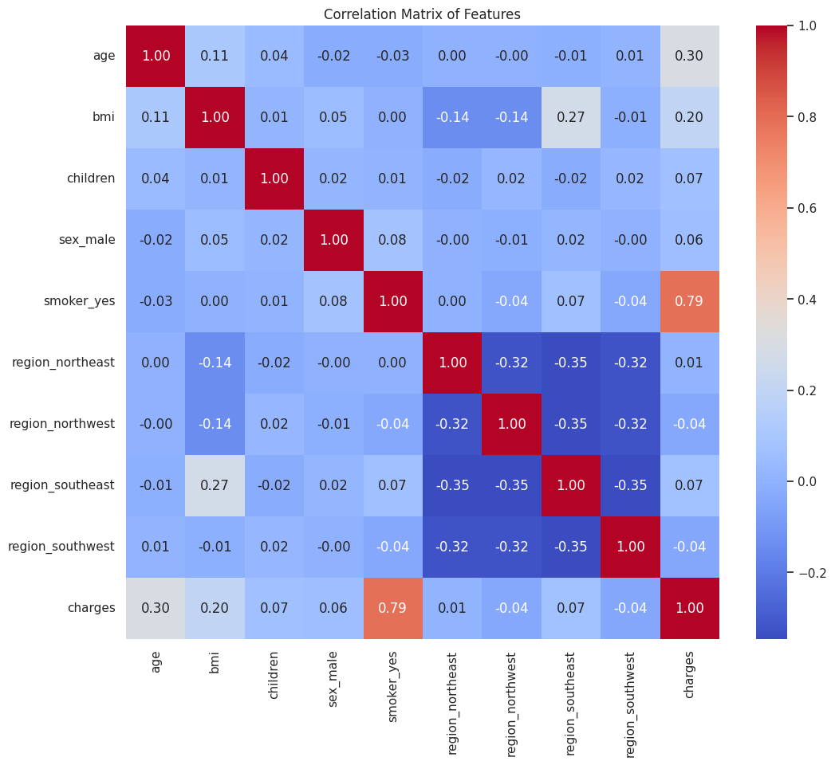
Exploratory Data Analysis (EDA)
High linear correlation between smoking and charges
Weak linear correlation between BMI and age to charges
No linear correlation between children and charges

Slide 6
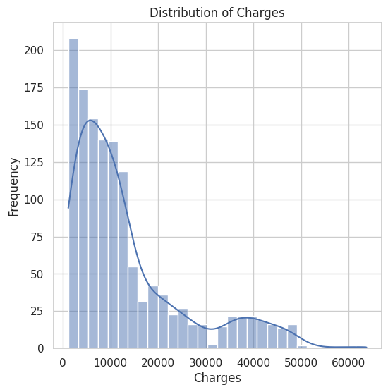
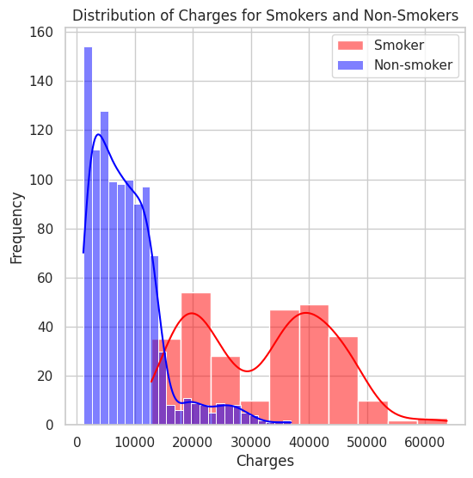
Exploratory Data Analysis (EDA) and Visualization

Slide 7
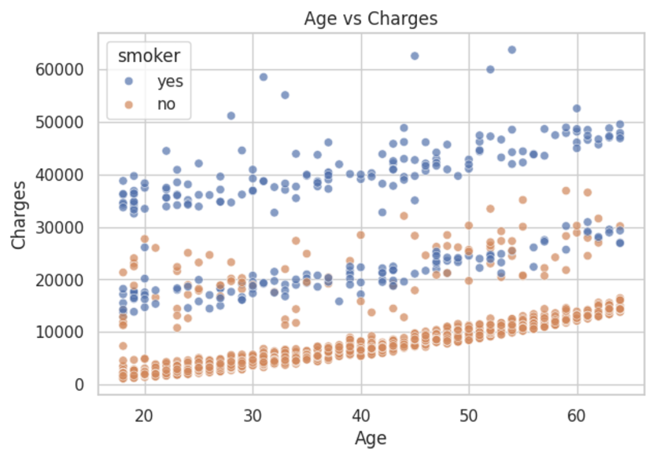
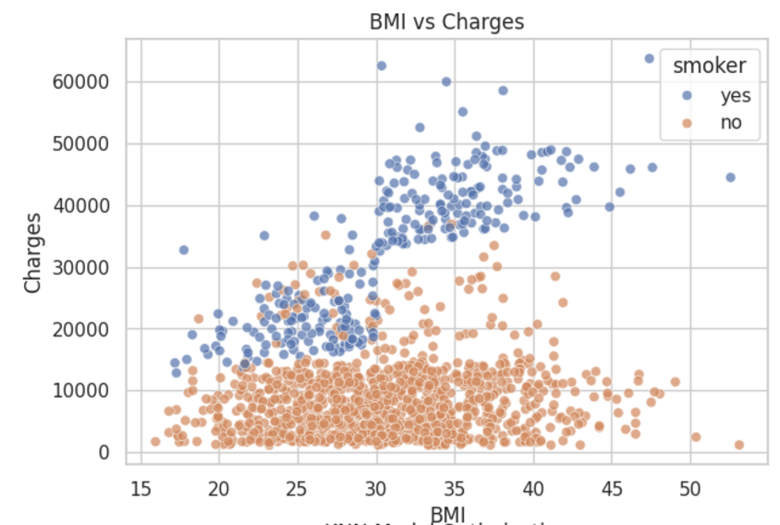
Continued Visualization

Slide 8
Models and Regularization Techniques
Linear regression with L1 (LASSO) regularization
Decision Tree with GridSearchCV - performs grid search across a range of hyperparameters
Random Forest with with GridSearchCV to tune hyperparameters (ie. max depth and split)
K-nearest neighbors with standardized data and optimal K value
Dense neural network with dropout layers

Slide 9
Results
Model | Train MSE | Test MSE
Linear Regression | 37,277,711 | 33,605,932
Decision Tree | 21,120,357 | 22,812,669
Random Forest | 8,273,732 | 20,155,211
Dense Neural Network | 34,704,355 | 30,746,318
K-Nearest Neighbor | 18,119,239 | 29,058,240

Slide 10
Analysis
Even though the MSEs are quite large, we are working with large numbers so this is natural.
The values still seem quite large when you take the root of them, but this is because of outlier data points and in most cases, the model generalizes to a few hundred dollars off the actual value.
The best performing model was the random forest model.
  The Test MSE for this model is significantly higher than the Train MSE implying that the model is overfit, however it still performs best comparatively

Slide 11
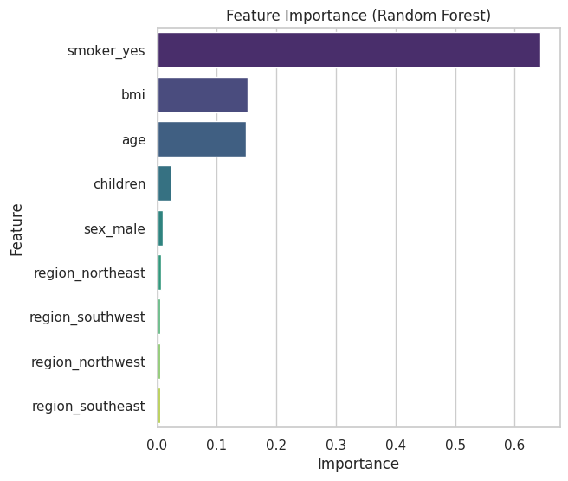
Conclusion
Key Insights
  Best Model: The Random Forest model outperformed other models, achieving the lowest test MSE.
  Key Predictors: Analysis of Random Forest feature importance revealed that smoker status, bmi, and age are the most influential variables in predicting insurance charges.
Limitations
  Overfitting in the Random Forest model indicates a need for further regularization or additional training data.
Future Directions
  Incorporate additional predictors, such as exercise habits or family medical history, to improve predictive power.

Slide 12
References
https://www.kaggle.com/datasets/mirichoi0218/insurance/data

Slide 13
Thank you!

